Slide 1
Credit card fraud detection using Supervised Learning Classification
Mentor Gabrilla Sabadini H
Team Members
Gopi Selvaraj

Slide 2
Problem Definition
The objective of this project is to develop a robust and accurate credit card fraud detection model using supervised learning classification techniques in the finance sector. The model should be able to classify transactions or activities into binary classes: "fraudulent" and "non-fraudulent" based on historical available data and the significant features.
The dataset provided for this project contains historically available transaction data, where each transaction is described by a set of features. These features include customer information, transaction amount, transaction date and time, credit card information and other relevant details. Additionally, each transaction is classified as either "fraudulent" or "non-fraudulent”.

Slide 3
Data dictionary
S.No | Field name | Description | Data type
1 | Accountnumber | Unique identifier for the account associated with the transaction. | Int64
2 | Customerid | Unique identifier for the customer associated with the account. | Int64
3 | Creditlimit | The credit limit assigned to the account. | Float64
4 | Availablemoney | The available balance in the account. | Float64
5 | Transactiondatetime | Date and time of the transaction. | Object
6 | Transactionamount | The amount of money involved in the transaction. | Float64
7 | Merchantname | Name of the merchant where the transaction took place. | Object
8 | Acqcountry | Country where the acquiring bank is located. | Object
9 | Merchantcountrycode | Country code of the merchant's location. | Object
10 | Posentrymode | Point of service (POS) entry mode for the transaction. | Float64
11 | Posconditioncode | Condition of the POS at the time of the transaction. | Float64
12 | Merchantcategorycode | Code indicating the category of the merchant. | Object
13 | Currentexpdate | Expiration date of the card at the time of the transaction. | Object
14 | Accountopendate | Date when the account was opened. | Object
15 | Dateoflastaddresschange | Date of the last address change on the account. | Object
16 | Cardcvv | CVV (card verification value) of the card. | Int64
17 | Enteredcvv | CVV entered during the transaction. | Int64
18 | Cardlast4digits | Last 4 digits of the card number. | Int64
19 | Transactiontype | Type of the transaction (e.G., Purchase, cash advance). | Object
20 | Echobuffer | An echo buffer associated with the transaction. | Float64
21 | Currentbalance | Current balance in the account. | Float64
22 | Merchantcity | City where the merchant is located. | Float64
23 | Merchantstate | State where the merchant is located. | Float64
24 | Merchantzip | ZIP code of the merchant's location. | Float64
25 | Cardpresent | Indicator whether the card was present during the transaction. | Bool
26 | Posonpremises | Indicator whether the POS was on the merchant's premises. | Float64
27 | Recurringauthind | Indicator for recurring authorization. | Float64
28 | Expirationdatekeyinmatch | Indicator whether the expiration date matches during key-in transactions. | Bool
29 | Isfraud | Indicator whether the transaction is fraudulent. | Bool

Slide 4
Shape and distribution of the target variable
The dataset has 786363 observation & 29 variables. The complexity is in finding the solution to the problem based on the chosen sampling techniques.
(Stratified sampling & Smote Sampling)
Due to the huge size of the dataset, have opted for ‘Stratified sampling’ considering the original dataset as population and the sample dataset contains 150000 observation & 29 variables.
When calculating the distribution of the target variable, we can see the Majority class is non-fraudulent transactions / ‘False’ & Minority class is fraudulent transactions / ‘True’ with ratio of 98.5 : 1.5
Python Version:
‘3.11.5 | packaged by Anaconda, Inc.

Slide 5
Dropping Variables
Dropping columns with 100% null values, which includes
Excluding the following variables from the dataset, as they are irrelevant to the target variable and further may introduce unwanted confusion during model building:
echoBuffer | merchantCity
merchantState | merchantZip
posOnPremises | recurringAuthInd
accountNumber | customerId
transactionDateTime | currentExpDate
accountOpenDate | dateOfLastAddressChange
merchantCountryCode | cardLast4Digits
cardCVV | enteredCVV

Slide 6
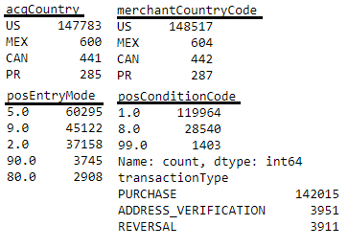
Missing Value Imputation
Due to high imbalance sub-classes in the missing value categorical columns
instead of mode imputation, we have opted for either ‘backward fill’ / ‘forward fill’ to
avoid bias towards the most repeated subclass.
Outlier Treatment:
Even though we can see huge no. of outliers in the numeric columns, have refrained from removing any outliers in the dataset, given its financial nature.

Slide 7
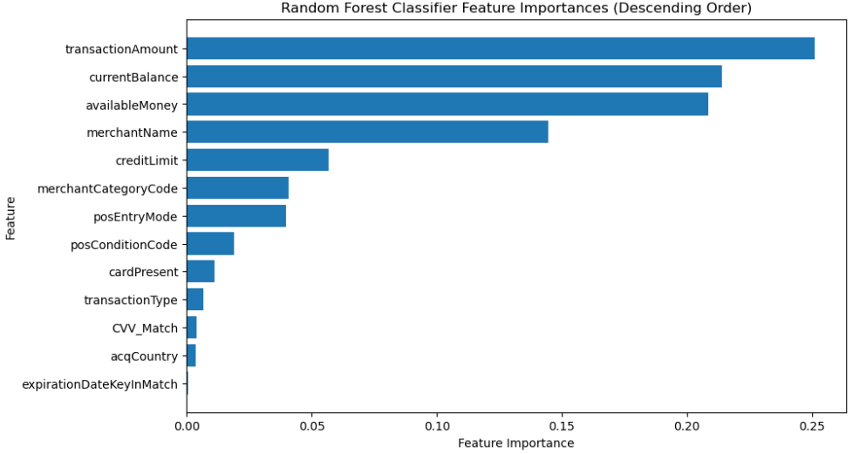
Feature Importance using Random Forest Classification:

Slide 8
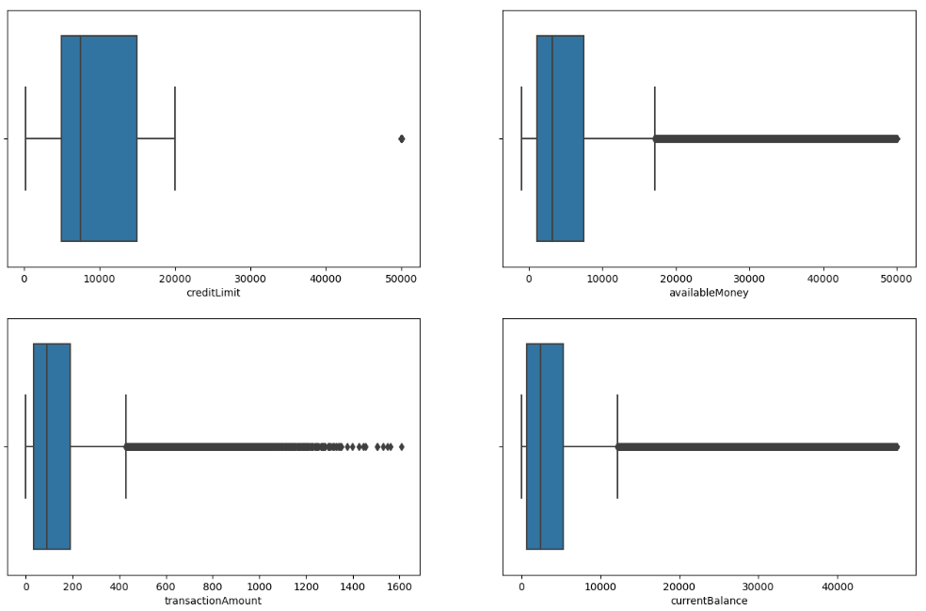
Exploratory Data Analysis
Univariate analysis - Numeric variables
Boxplot:

Slide 9
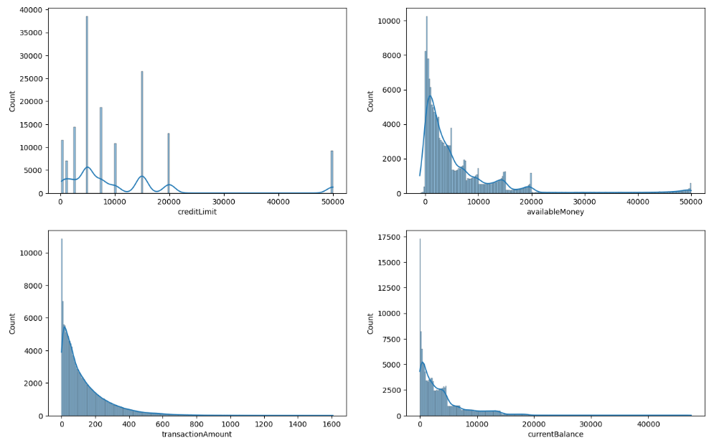
Numeric variables
Histogram:

Slide 10
Inference:
Highly skewed(mean>median>mode) data in the numeric variables indicating presence of outliers in the higher scale in all numeric variables.
'creditLimit’
High positive skewness(2.2) indicating presence of outliers in higher scale.
50% of the 'credit limit' values lie between 5000 and 15000.
We can see outlier value of 50000
‘availableMoney’
High positive skewness(3) indicating presence of outliers in higher scale & we can see huge no. of outliers.
50% of the avaiableMoney values lie between 1079 and 7500
We can see outlier value of 50000 (we have also seen the outlier value in ‘creditLimit’ as well)
‘transactionAmount’
High positive skewness(2.11) indicating presence of outliers in higher scale & we can see huge no. of outliers.
50% of the avaiableMoney values lie between 33.6 and 191.4 indicating most of the transactions are of low value
We can most outliers lie around 450 too 1300
We can see extreme outlier value of 1608.3
'currentBalance'
High positive skewness(3.3) indicating presence of outliers in higher scale & we can see huge no. of outliers
50% of the ‘currentBalance’ values lie between 700.3 and 5291
Most of the high credit limit customers have not spend most of the money from their credit card.
We can see an extreme outlier value of 47498.8

Slide 11
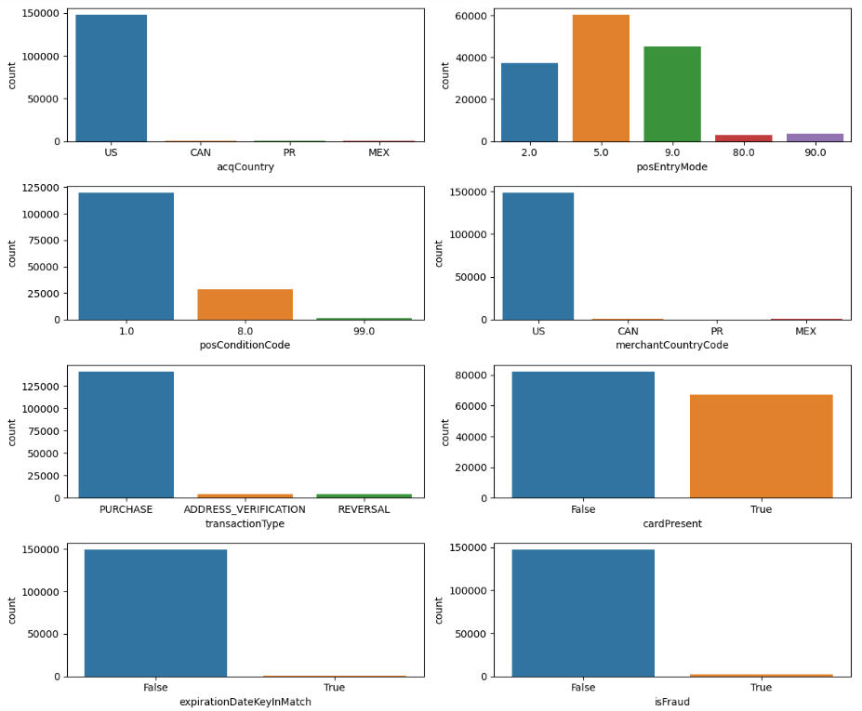
Univariate analysis - Categorical variables
Countplot:

Slide 12
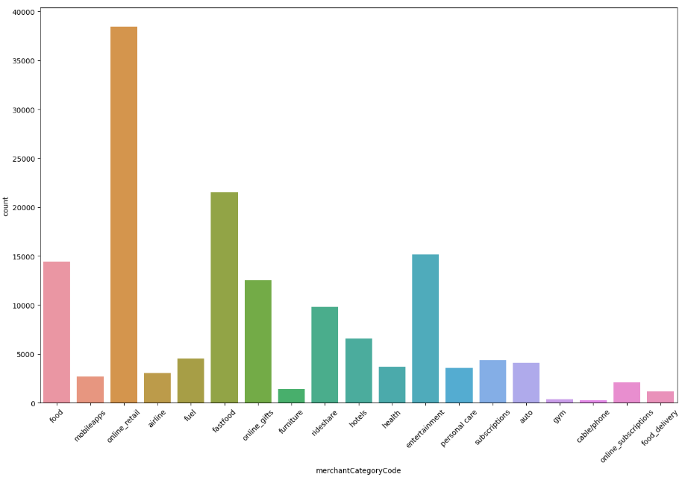
Univariate analysis - Categorical variables
Countplot:

Slide 13
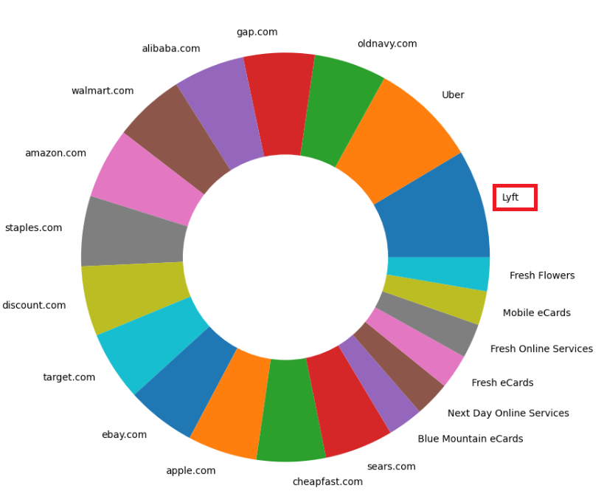
Univariate analysis Categorical variables
Pie-plot:

Slide 14
Inference:
'acqCountry'
No. of subclasses = 4 & high imbalance in distribution of subclasses.
Most of the merchants(148286) are from country 'US'.
We can find data imbalance within subclasses are very few no. of values belong to 'MEX' , 'CAN' & 'PR'.
Least no. of merchants(290) belong to country Puerto Rico/'PR’.
'merchantCountryCode'
No. of subclasses = 4 & high imbalance in distribution of subclasses.
Most of the merchants(148285) belong to country code 'US'.
We can find data imbalance within subclasses are very few no. of values belong to 'MEX' , 'CAN' & 'PR'.
Least no. of merchants(288) belong to country code Puerto Rico/'PR'.
We can observe the distribution of values in 'acqCountry' & 'merchantCountryCode' is very similar. Both columns might be representing the country in which the transaction happened. The small difference in distribution of subclasses might be due to data collection/entry.
Instead of having both of them in the final model its best we have only one column (Eg.'acqCountry’)
'posEntryMode'
No. of subclasses = 5 . Values are distributed generally in 5.0, 9.0 & 2.0. Fewer of values in 90.0 & 80.0
Most of the transactions(60452) used '5'/'PAN auto-entry via chip' followed by transaction(62268) using '9'/'PAN entry via electronic commerce, including remote chip'.
Least no. of transaction(2907) were from 80. This might happen if there's a problem with the chip reader/ chip on the card is damaged/ if there's some other technical issue. Indicating compromise in security.

Slide 15
'posConditionCode'
No. of subclasses = 3 & high imbalance in distribution of subclasses.
Most of the transactions(119734) were successful belonging to '1' followed by voided transactions(28482) belonging to '8'.
Least no. of transactions(1396) were belonged to 99 indicating refund of money for that transaction.
'transactionType'
No. of subclasses = 3 & high imbalance in distribution of subclasses.
Most of the transactions(141755) belonged to type 'PURCHASE'.
Least no. of transaction(3912) belonged to type 'REVERSAL’.
'cardPresent'
No. of subclasses = 2 & values seems to be equally distributed among subclasses.
In most of the transactions(82486) the credit card was not physically present.
In least of the transactions(67126) the credit card not physically present.
'expirationDateKeyInMatch’
No. of subclasses = 2 & high imbalance in distribution of subclasses.
In most of the transactions(149403) there wasn't a match between the actual expiration date and the expiry date entered by the customer.
Least of the transactions(209) there was a match between the actual expiration date and the expiry date entered by the customer.

Slide 16
'isFraud'
No. of subclasses = 2 & high imbalance in distribution of subclasses.
We can see high class imbalance in target variable.
Most of the transactions(188288) were not fraud & least no. of transactions(2368) were fraud.
'merchantCategoryCode'
No. of subclasses = 19 & high imbalance in distribution of subclasses.
Most of the transactions(38468) were from 'online_retail' transactions.
Least no. of transactinos(269) were from 'cable/phone' transactions.
'merchantName'
Most of the transactions(6785) are from 'Lyft'.
Followed by 6612 transactions from 'Uber'.

Slide 17
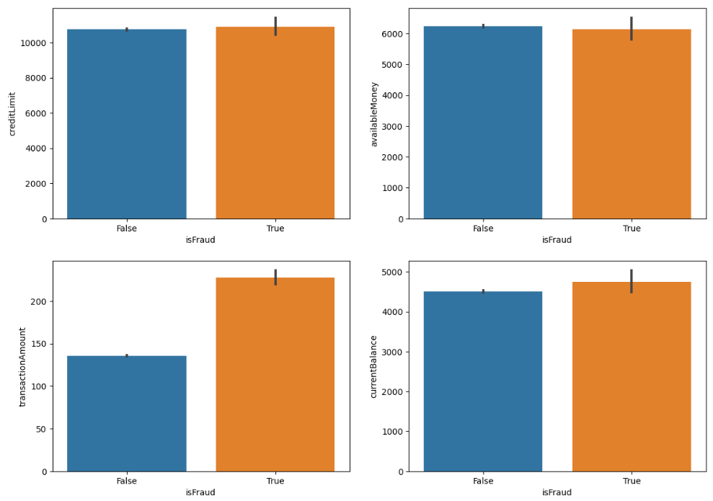
Bivariate analysis – Numerical VS Categorical
Barplot

Slide 18
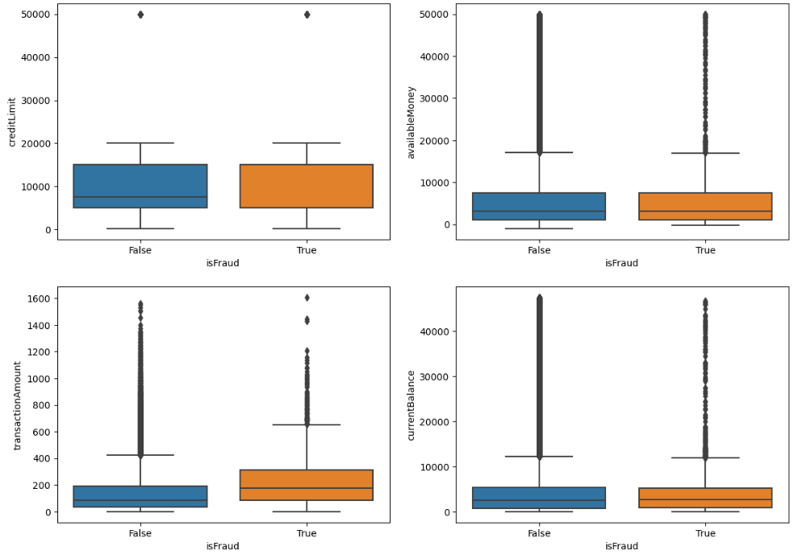
Boxplot

Slide 19
Inference:
'creditLimit' vs ‘isFraud’
We can there is no significant difference in the distribution of ‘creditLimit’ for fraudulent and non-fraudulent transactions.
50% of the data of ‘creditLimit’ for the fraudulent transactions & non-fraudulent transactions lie around 5000 to 15000.
'availableMoney' vs ‘isFraud’
We can there is no significant difference in the distribution of ‘availableMoney’ for fraudulent and non-fraudulent transactions.
50% of the data of ‘availableMoney’ for the fraudulent transactions lies around 1057.7 and 7425.1
50% of the data of ‘availableMoney’ for the non fraudulent fraudulent transactions lies around 1079.8 and 7500
There are huge no. of outliers in both categories.

Slide 20
'transactionAmount' vs ‘isFraud’
We can there is a significant difference in the distribution of ‘transactionAmount’ for fraudulent and non-fraudulent transactions.
50% of the data of ‘transactionAmount’ for the fraudulent transactions lies around 86.6 and 313.3
50% of the data of ‘transactionAmount’ for the non fraudulent fraudulent transactions lies around 33.1 and 189.
There are huge no. of outliers in both categories.
'currentBalance' vs ‘isFraud’
We can there is a very small variation in the distribution of ‘currentBalance’ for fraudulent and non-fraudulent transactions.
50% of the data of ‘currentBalance’ for the fraudulent transactions lies around 794.2 and 5215.8
50% of the data of ‘currentBalance’ for the non fraudulent fraudulent transactions lies around 699.205 and 5292.615
There are huge no. of outliers in both categories.

Slide 21
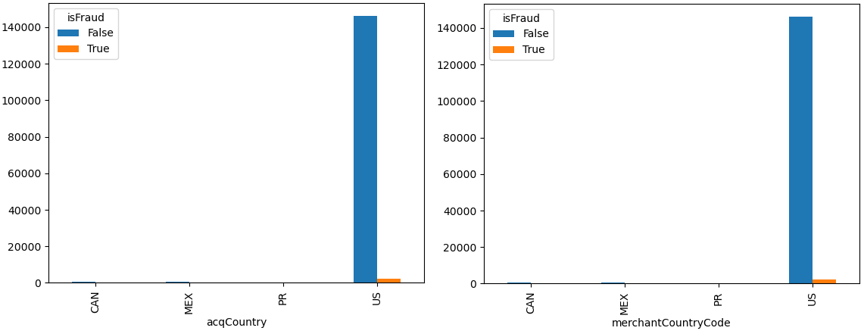
Bivariate analysis – Categorical VS Categorical
Crosstab

Slide 22
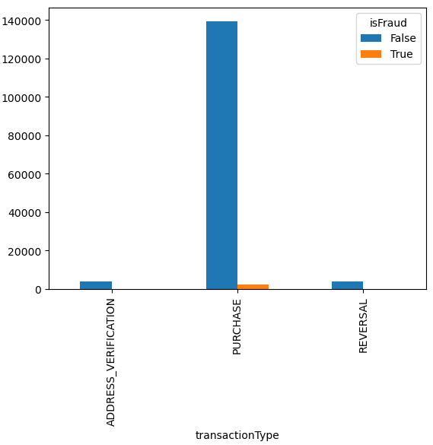
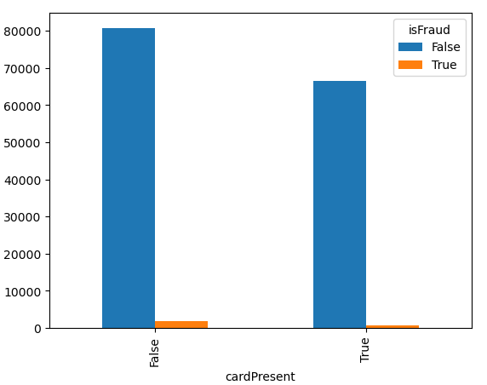
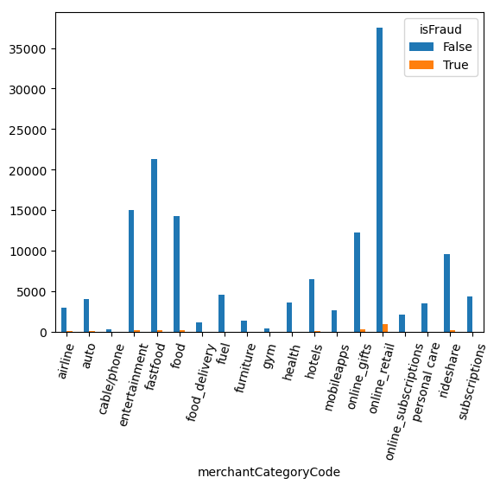
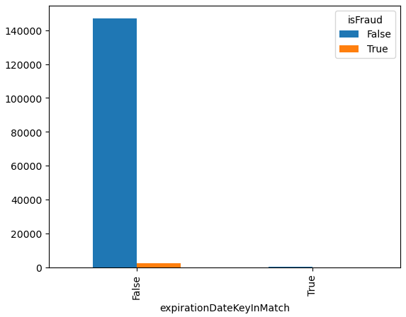

Slide 23
Inference:
'acqCountry' vs ‘isFraud’
Most fraudulent transactions(2342) are from ‘US’ followed by ‘MEX’/Mexico with 14 transactions & the least no. of fraudulent transactions(25) are from ‘PR’/Puerto-Rico.
Most non fraudulent transactions(145944) are from ‘US’ followed by ‘MEX’/Mexico with 579 transactions & the least no. of non fraudulent transactions(285) are from ‘PR’/Puerto-Rico.
'merchantCountryCode' vs ‘isFraud’
Most fraudulent transactions(2341) are from merchant country code ‘US’ followed by ‘Mex’ with 14 transactions & the least no. of fraudulent transactions(5) are from ‘PR’/Puerto-Rico.
Most non fraudulent transactions(145944) are from merchant country code ‘US’ followed by ‘Mex’ with 583 transactions & the least no. of non fraudulent transactions(283) are from ‘PR’/Puerto-Rico.
'transactionType' vs ‘isFraud’
Most fraudulent transactions(2285) are belong to purchase type ‘PURCHASE’ & the least no. of fraudulent transactions(25) are from ‘ADDRESS_VERIFICATION’.
Most non fraudulent transactions(139470) are belong to purchase type ‘PURCHASE’ & the least no. of non fraudulent transactions(3854) are from ‘REVERSAL’.

Slide 24
'cardPresent' vs ‘isFraud’
Most fraudulent transactions(1717) are where the card was physically not present & the least no. of fraudulent transactions(651) are where the card was physically present.
Most non fraudulent transactions(80769) are where the card was physically not present & the least no. of non fraudulent transactions(66475) are where the card was physically present.
'expirationDateKeyInMatch' vs ‘isFraud’
Most fraudulent transactions(2364) are where the expiration date didn’t match with the one entered by the customer & the least no. of fraudulent transactions(4) are where the expiration date matched with the one entered by the customer.
Most non fraudulent transactions(147039) are where the expiration date didn’t match with the one entered by the customer & the least no. of non fraudulent transactions(205) are where the expiration date matched with the one entered by the customer.

Slide 25
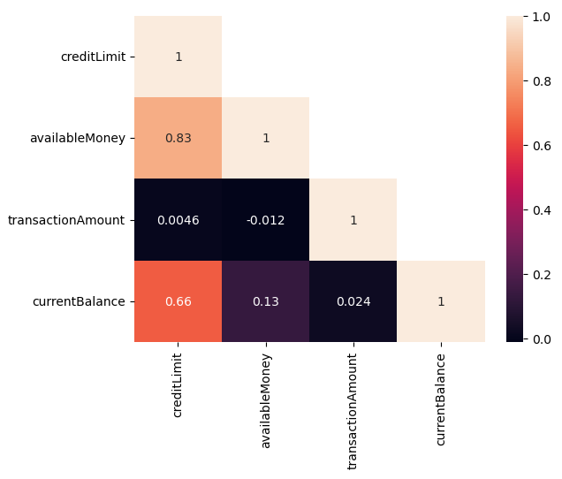
Multivariate analysis
Correlation plot
Inference:
We can infer the presence of Multi-collinearity from the above plot.
We can see high positive correlation(0.83) between 'creditLimit' & 'availableMoney’.
We can see high positive correlation(0.66) between 'creditLimit' & 'currentBalance’.
We can see very weak positive correlation(0.13) between 'currentBalance' & 'availableMoney'.

Slide 26
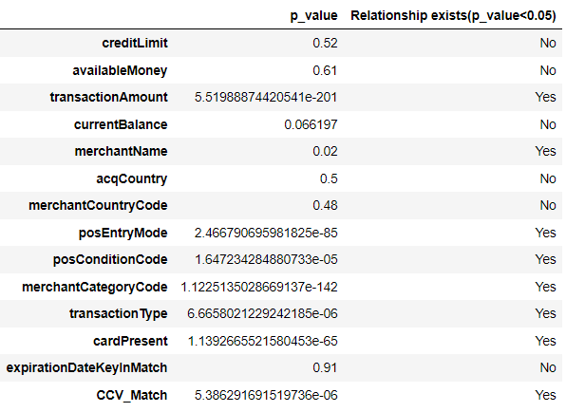
Statistical test of significance:
Numeric VS Categorical – Independent T test
Categorical VS Categorical – Chi square contingency test
Feature engineering:
We have two features ‘'cardCVV' & 'enteredCVV’ which represent the actual credit card CVV and the one entered by the customer. We can’t infer information from them as individual columns when they exist separately.
Hence we can create a new column ‘CVV_match’ that contains records of correct(1) or wrong(0) CVV entered by customer.

Slide 27
Scaling the data
Data preprocessing
Scaling is performed in the dataset for the numeric variables after train test split as we can hide the mean standard deviation of training data from the test data.
Outlier treatment:
The popular methods of handling the outliers are Trimming/removing the outlier based on IQR or z-Score or capping them. We would like to consider the outliers in this dataset as a pattern and prefer not to treat them but to handle them differently since it is important for the model to get trained based on some extreme values in order to predict in an efficient way consider their nature in the financial sector.
Transformation technique:
We prefer transformation of the numeric variables(using Yeo-Johnson transformation) so that we can try to convert them to near normal distribution instead of opting for any outlier treatment.

Slide 28
Encoding the Categorical Variables:
The performance of a machine learning model not only depends on the model and the hyperparameters but also on how we process and feed different types of variables to the model. Since most machine learning models only accept numerical variables, pre-processing the categorical variables becomes a necessary step. Converting these categorical variables to numbers such that the model is able to understand and extract valuable information is known as Encoding. There are various encoding techniques available like Dummies, One Hot Encoder, Label Encoder, Ordinal Encoder etc., We have used Label Encoder for encoding our categorical variables considering the no. of categorical variables and we have also seen there is not a significant improvement in model performance when dummy encoding was utilized.
We use Label encoding technique when the categorical feature is ordinal. In this case, retaining the order is important. Hence encoding should reflect the sequence. In Label encoding, each label is converted into an integer value. We will create a variable that contains the categories representing the education qualification of a person likewise.
The final processed data which we would be using in building various Classification Models like Logistic Regression, Decision Tree, Random Forest etc. We, with the help of the built models we would infer on the significance and effects of each independent variable on our target variable for predicting the patterns and rate of successful conversion to give some insightful ideas for effective marketing.

Slide 29
Model Building & Evaluation
The Modeling is the core of any machine learning project. This step is responsible for the results that should satisfy or help satisfied the project goals.
Building a model in machine learning is creating a mathematical representation by generalizing and learning from training data.
Our problem statement come under the Classification thus we have decided to use various models namely
Logistic Regression Model
Decision Tree Model
Random Forest Model
Naïve Bayes Model
Ada Boost Technique
Gradient Boosting Technique
eXtreme Gradient Boosting Technique
Evaluation: Recall, Precision, Accuracy & F1 Score (wieghted)

Slide 30
Stratified Sampling & SMOTE Techniques
Since our Data Set is Very Large classification data is an imbalanced data, it is desirable to sample the dataset into Sampling Datasets in a way that preserves the same proportions of examples in each class as observed in the Original Dataset. This is called a Stratified Sampling.
We can achieve this by setting the “Stratify” argument to the Merchant Category Code component of the original dataset. & we Have 150000 Rows after Sampling
Once the Sample is taken from various random state of 4 this Sample will be used for the various model with various combination, various ensemble and Stacking Techniques
Smote Has Been Done on Train Data Only and Test is Passed for Evaluation Metrics. Although we don’t prefer SMOTE as its not representative of the real world data.
Population Target Variable Proportion |  | Sample Target Variable Proportion
False | 98.42096 | False | 98.42096
True | 1.579042 | True | 1.579042
Value Counts of Train and Test
Target Variable Value Counts Train on SMOTE: 235590
Target Variable Value Counts Test: 29923

Slide 31
Hyper tuning the model
Model: Decision Tree Classifier Without SMOTE
Parameter Used:
GridSearchCV
Criterion | Entropy, Gini
Max Depth | 30, 35, 40
Min Samples Split | 50, 60, 70, 80, 90
Min Samples Leaf | 10, 20, 30, 40
Best Parameters
Criterion | Entropy
Max Depth | 30
Min Samples Split | 80
Min Samples Leaf | 10

Slide 32
Model performance - Training scores
Model | Accuracy | Recall | Precision | F1 Score | TN | FN | FP | TP
Logistic Regression [Base model] - Train | 0.984176 | 0.984176 | 0.984426 | 0.976327 | 117795 | 1894 | 0 | 0
Decision Tree [base model] - Train | 1.000000 | 1.000000 | 1.000000 | 1.000000 | 117795 | 0 | 0 | 1894
Decision Tree [significant columns] - Train | 0.997067 | 0.997067 | 0.997070 | 0.996923 | 117792 | 348 | 3 | 1546
Random forest [significant columns] - Train | 0.996992 | 0.996992 | 0.996972 | 0.996852 | 117779 | 344 | 16 | 1550
Adaboost [significant columns] - Train | 0.997067 | 0.997067 | 0.997065 | 0.996925 | 117789 | 345 | 6 | 1549
Gradientboost [significant columns] - Train | 0.984318 | 0.984318 | 0.982064 | 0.976743 | 117791 | 1873 | 4 | 21
XGboost [significant columns] - Train | 0.984176 | 0.984176 | 0.984426 | 0.976327 | 117795 | 1894 | 0 | 0
Gaussian NB - Train | 0.975821 | 0.975821 | 0.969269 | 0.972502 | 116760 | 1859 | 1035 | 35
Decision Tree [SC] [SMOTE] - Train | 0.997742 | 0.997742 | 0.997752 | 0.997742 | 117791 | 528 | 4 | 117267
Random forest [SC] [SMOTE] - Train | 0.997423 | 0.997423 | 0.997424 | 0.997423 | 117559 | 371 | 236 | 117424

Slide 33
Model performance - Test scores
Model | Accuracy | Recall | Precision | F1 Score | TN | FN | FP | TP
Logistic Regression [Base model] - Test | 0.984159 | 0.984159 | 0.984410 | 0.976302 | 29449 | 474 | 0 | 0
Decision Tree [base model] - Test | 0.968085 | 0.968085 | 0.969989 | 0.969033 | 28941 | 447 | 508 | 27
Decision Tree [significant columns] - Test | 0.971260 | 0.971260 | 0.970464 | 0.970861 | 29032 | 443 | 417 | 31
Random forest [significant columns] - Test | 0.972362 | 0.972362 | 0.970632 | 0.971492 | 29064 | 442 | 385 | 32
Adaboost [significant columns] - Test | 0.972162 | 0.972162 | 0.970548 | 0.971350 | 29059 | 443 | 390 | 31
Gradientboost [significant columns] - Test | 0.983992 | 0.983992 | 0.968567 | 0.976219 | 29444 | 474 | 5 | 0
XGboost [significant columns] - Test | 0.984126 | 0.984126 | 0.968569 | 0.976286 | 29448 | 474 | 1 | 0
Gaussian NB - Test | 0.976172 | 0.976172 | 0.969107 | 0.972595 | 29203 | 467 | 246 | 7
Decision Tree [SC] [SMOTE] - Test | 0.662099 | 0.662099 | 0.974010 | 0.782732 | 19550 | 212 | 9899 | 262
Random forest [SC] [SMOTE] - Test | 0.660395 | 0.660395 | 0.974132 | 0.781481 | 19496 | 209 | 9953 | 265

Slide 34
.
Best models that have been achieved without SMOTE
Random forest
Ada boosting

Slide 35
Top 5 important Features from best Model:
These are the most significant columns which we have found after comparing the pvalue<0.05 after building a stats logistic regression model
'transactionAmount'
'posEntryMode'
'posConditionCode'
'cardPresent'
'CVV_Match'

Slide 36
Business Interpretation:
Implement proactive measures for customer information updates and security enhancements.
Utilize dynamic credit limits based on transaction history.
Scrutinize larger transactions for fraud prevention.
Prioritize monitoring for accounts with low available funds.
Allocate extra resources for fraud prevention during seasonal peaks.
Implement real-time monitoring for transaction volume changes.
Emphasize security for accounts with higher available funds.
Adjust security measures with changes in transaction entry modes.
Tailor security to account for varying vulnerability levels.
Refine fraud detection strategies based on transaction characteristics.

Slide 37
References
https://www.kaggle.com/datasets/iabhishekbhardwaj/fraud-detection(Dataset)
https://www.fraud.com/post/the-history-and-evolution-of-fraud (Background Research)
https://www.amygb.ai/blog/how-fraud-detection-works-in-banking (Application)
https://www.sciencedirect.com/science/article/pii/S0957417421017164 (Past Reasearch)
https://ieeexplore.ieee.org/document/10085493 (Ongoing Research)

